Slide 1
RC4
By
Razia Nisar Noorani
Asst. Professor
SSUET

Slide 2
Stream Cipher
The RC4 Stream Cipher:
RC4 is a stream cipher designed in 1987 by Ron Rivest. It is a variable key-size stream cipher with byte-oriented operations. The algorithm is based on the use of a random permutation.
The period of the cipher is likely to be greater than 10¹⁰⁰ .
The cipher can be expected to run very quickly in software.
RC4 is used in WEP (Wired Equivalent Privacy) and WPA (WiFi Protected Access ), which are encryption protocols commonly used on wireless routers. RC4 was originally very widely used due to its simplicity and speed.
The main issue in this type of cipher is not with RC4 itself but the way in which keys are generated for use as input to RC4. Over time this code was shown to produce biased outputs towards certain sequences, mostly in first few bytes of the keystream generated.

Slide 3
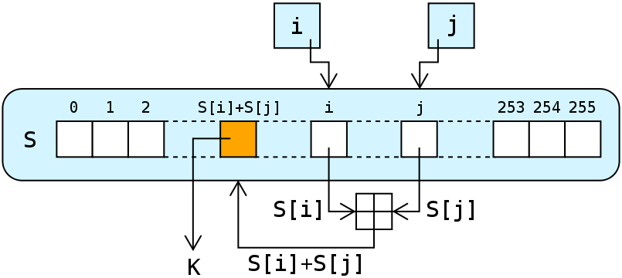
RC4 Procedure
The RC4 algorithm:
A variable-length key of from 1 to 256 bytes (8 to 2048 bits) is used to initialize a 256-byte state vector S, with elements S[0], S[1],..., S[255]. For encryption and decryption, a byte K is generated from S by selecting one of the 255 entries in a systematic fashion. As each a new generated value of K, the entries in S are once again permuted.
Step 1: Initialization of S
To begin, (a) the entries of S are set equal to
the values from 0 through 255 in ascending
order; that is; S[0] = 0, S[1] = 1,...,S[255] = 255.
(b) A temporary vector, T, is also created.
If the length of the key K is 256 bytes,
then K is transferred to T. Otherwise, for
a key of length keylen bytes,
the first keylen elements of T are copied from K
and then K is repeated as many times as necessary to fill out T.

Slide 4
RC4 Algorithm
The preliminary operations can be summarized as follows:
for i = 0 to 255 do
S[i] = i;
T[i] = K[i mod keylen];
Step 2: Initial Permutation of S
Next we use T to produce the initial permutation of S. This involves starting with S[0] and going through to S[255], and, for each S[i], swapping S[i] with another byte in S according to a scheme dictated by T[i]:
j = 0;
for i = 0 to 255 do
j = (j + S[i] + T[i]) mod 256;
Swap (S[i], S[j]);
Because the only operation on S is a swap, the only effect is a permutation. S still contains all the numbers from 0 through 255.

Slide 5
RC4 Algorithm
Step3: Stream Generation
Once the S vector is initialized, the input key is no longer used. Stream generation involves cycling through all the elements of S[i], and, for each S[i], swapping S[i] with another byte in S according to a scheme dictated by the current configuration of S. After S[255] is reached, the process continues, starting over again at S[0]:
i, j = 0;
while (true)
i = (i + 1) mod 256;
j = (j + S[i]) mod 256;
Swap (S[i], S[j]);
t = (S[i] + S[j]) mod 256;
K = S[t];
Step 4: Encryption
To encrypt, XOR the value K with the next byte of plaintext. To decrypt, XOR the value K with the next byte of ciphertext.

Slide 6
Simplified RC4 Example
Lets consider the stream cipher RC4, but instead of the full 256 bytes, we will use 8 × 3-bits. That is, the state vector S is 8 × 3-bits. We will operate on 3-bits of plaintext at a time since S can take the values 0 to 7, which can be represented as 3 bits.

Slide 7
Simplified RC4 Example
Assume we use a 4 x 3-bit key, K, and plaintext P as below:
K = [1 2 3 6]
P = [1 2 2 2]
The first step is to generate the stream.
Initialise the state vector S and temporary vector T.
S is initialised so the S[i] = i, and T is initialised so it is the key K (repeated as necessary).
S = [0 1 2 3 4 5 6 7]
T = [1 2 3 6 1 2 3 6]

Slide 8
Simplified RC4 Example
Now perform the initial permutation on S.
j = 0;
for i = 0 to 7
do j = (j + S[i] + T[i]) mod 8 Swap(S[i],S[j]);
end

Slide 9
Simplified RC4 Example
Now we generate 3-bits at a time, k, that we XOR with each 3-bits of plaintext to produce the ciphertext. The 3-bits k is generated by:
i, j = 0;
while (true)
{
i = (i + 1) mod 8;
j = (j + S[i]) mod 8;
Swap (S[i], S[j]);
t = (S[i] + S[j]) mod 8;
k = S[t];
}

